Slide 1



DAY 2

Slide 2
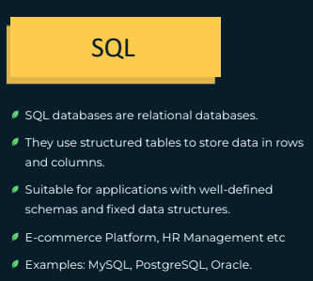
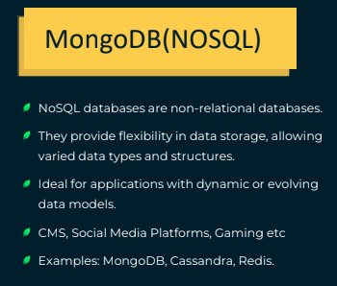

Slide 3
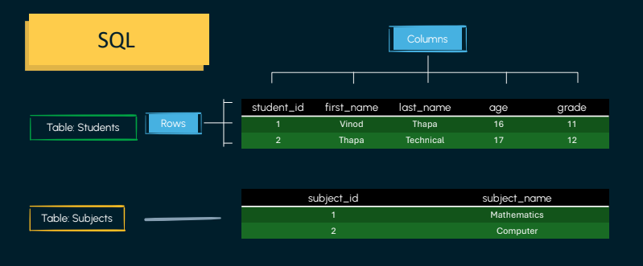

Slide 4
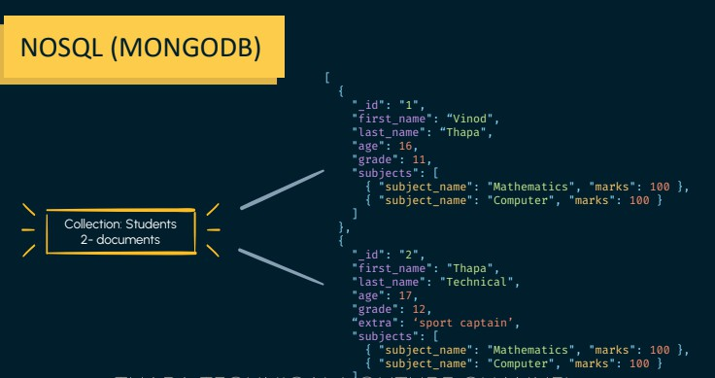

Slide 5
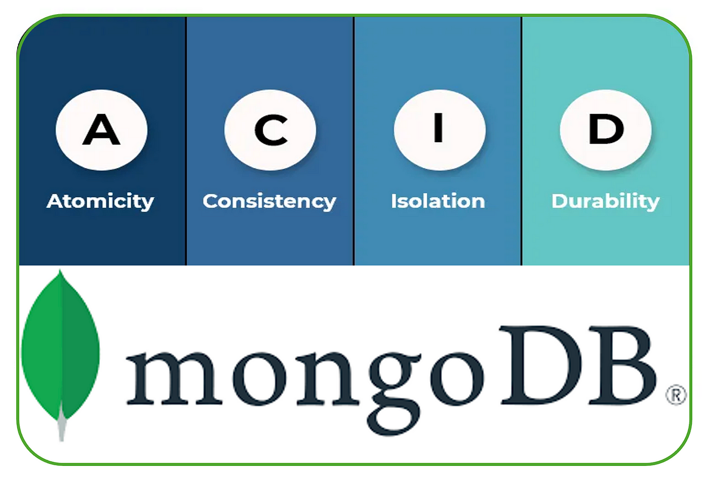

Slide 6
Does MongoDB Support ACID Now?
✅ Since MongoDB 4.0, multi-document transactions are ACID-compliant, but they are slower than SQL databases.
💡 Best practice: Use embedded documents when possible to avoid transactions!
Link: https://www.mongodb.com/resources/basics/databases/acid-transactions

Slide 7
Why MongoDB Lacked ACID?
1️⃣ Document-Oriented Model → Related data is often stored in a single document, making transactions unnecessary.
2️⃣ Horizontal Scaling → ACID requires synchronization across multiple nodes, which slows performance.
3️⃣ Eventual Consistency → MongoDB allows flexible write concerns, prioritizing speed over strict durability.
4️⃣ No Multi-Document Transactions (Before v4.0) → Transactions were limited to a single document, unlike SQL which supports multi-table transactions.
5️⃣ Performance Trade-Off → ACID transactions add locking and coordination overhead, reducing MongoDB’s speed.

Slide 8
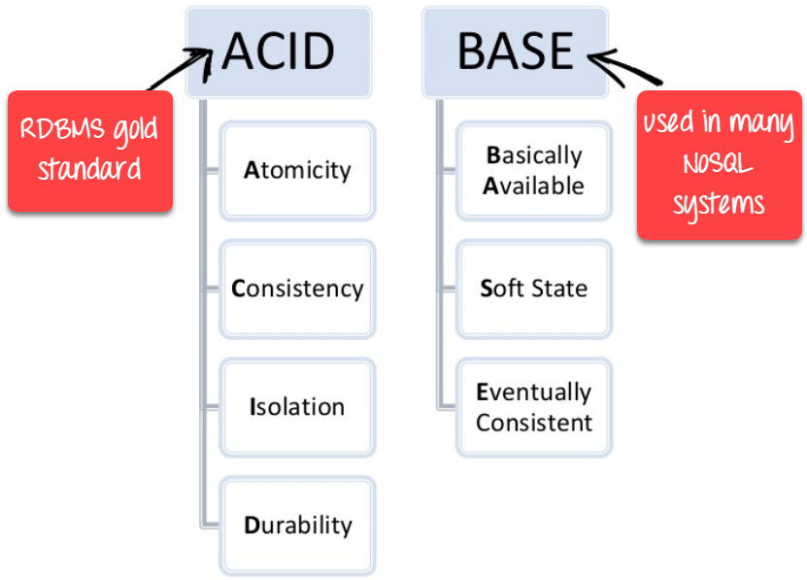

Slide 9
Three Key Principles of BASE
1️⃣ Basic Availability
The database is always available, even if some parts of the system fail.
Achieved by replicating data across multiple nodes instead of relying on a single storage system.
A failure may result in temporary data unavailability, but the database as a whole remains functional.

Slide 10
Three Key Principles of BASE
2️⃣ Soft State
The database does not require immediate consistency across all nodes.
Data may change even without new inputs due to eventual consistency mechanisms.
Example: Unlike a traditional light switch (which stays ON until turned OFF), NoSQL data can change automatically due to background updates.

Slide 11
Three Key Principles of BASE
3️⃣ Eventual Consistency
The database does not guarantee instant consistency after a write operation.
Instead, changes propagate over time, ensuring that all copies of data eventually become consistent.
Example: In a distributed system, if a user updates their profile, some servers may show the old version temporarily until synchronization completes.

Slide 12
Why Use BASE?
Best for big data, real-time applications, and distributed systems (e.g., Facebook, Twitter, Google).
Scales horizontally without the performance bottlenecks of ACID databases.
Works well when instant consistency isn’t critical (e.g., social media posts, recommendation systems).

